Slide 1



Lecture 4: Chat Service
COMP260: Distributed Systems
BSc (Hons) Computing for Games

Slide 2
Today’s session:
Demo
Chat service Spec
Chat service Design
Chat service key implementational issues

Slide 3
Demo

Slide 4
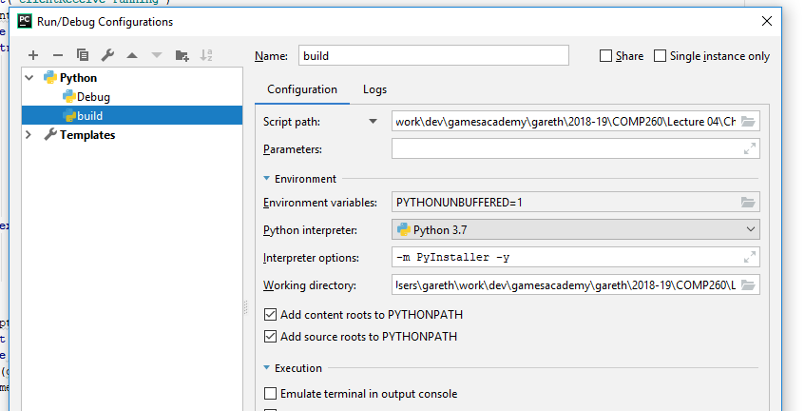
Demo
For ease of use, I’ve added a build configuration that will make .exe of python
Need to install PyInstaller
Run build configuration (don’t debug it)
Build folder will be created containing .exe and associated .dll and other files

Slide 5
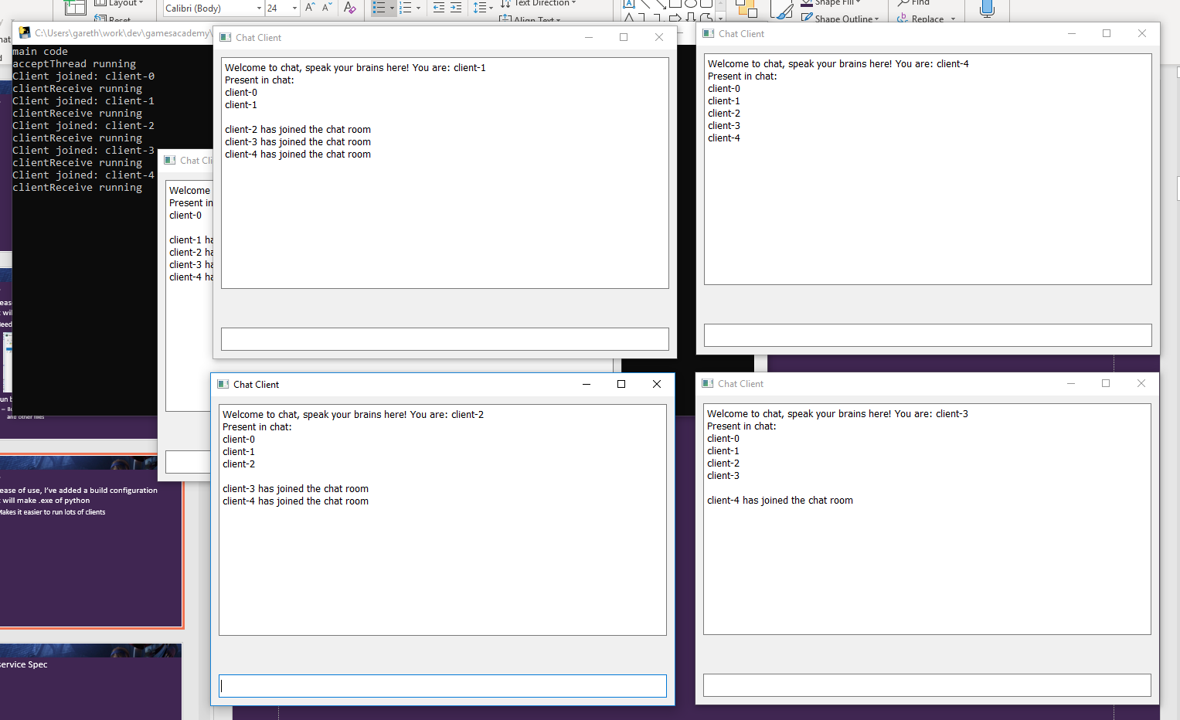
Demo
For ease of use, I’ve added a build configuration that will make .exe of python
Makes it easier to run lots of clients

Slide 6
Chat service Spec

Slide 7
Chat service Spec
You have been hired to develop a ‘chat service’ that will consist of client and server applications that communicate using the IP protocol.
Users can run a graphical client application (Python & PyQt5) which will connect to the server. Once connected, any messages the user enters will be sent to the rest of the clients currently connected by way of the server. When a client joins or leaves the service, all other users will be informed.
The service will be robust in that client or server termination or unavailability will not adversely affect the remaining clients and/or server.

Slide 8
Chat service Design

Slide 9
Chat service Design
Step 1: Do some analysis
What happens if we perform a linguistic decomposition on the spec
You have been hired to develop a ‘chat service’ that will consist of client and server applications that communicate using the IP protocol.
Users can run a graphical client application (Python & PyQt5) which will connect to the server. Once connected, any messages the user enters will be sent to the rest of the clients currently connected by way of the server. When a client joins or leaves the service, all other users will be informed.
The service will be robust in that client or server termination or unavailability will not adversely affect the remaining clients and/or server.

Slide 10
Chat service Design
Step 1: Do some analysis
What happens if we perform a linguistic decomposition on the spec
Objects (nouns), methods (verbs) , attributes (adjectives)
You have been hired to develop a ‘chat service’ that will consist of client and server applications that communicate using the IP protocol.
Users can run a graphical client application (Python & PyQt5) which will connect to the server. Once connected, any messages the user enters will be sent to the rest of the clients currently connected by way of the server. When a client joins or leaves the service, all other users will be informed.
The service will be robust in that client or server termination or unavailability will not adversely affect the remaining clients and/or server.

Slide 11
Chat service Design
Step 1: Do some analysis
What happens if we perform a linguistic decomposition on the spec
LD doesn’t guarantee a simple path, there is scope for ambiguity
Connected as a verb
Connected as an adjective
Work to earn your salary mr. technical designer
You have been hired to develop a ‘chat service’ that will consist of client and server applications that communicate using the IP protocol.
Users can run a graphical client application (Python & PyQt5) which will connect to the server. Once connected, any messages the user enters will be sent to the rest of the clients currently connected by way of the server. When a client joins or leaves the service, all other users will be informed.
The service will be robust in that client or server termination or unavailability will not adversely affect the remaining clients and/or server.

Slide 12
Chat service Design
Step 2: First pass class hierarchy
Class | Methods | Attributes
Chat service |  | Client Server
Client | Connect Terminate Join Leave Communicate(server) | Message
Server | Communicate(client) Terminate Send (message) Inform (user) | Message

Slide 13
Chat service Design
Step 3: Add some sense
Class | Methods | Attributes
Chat service |  | Client Server
Client | Connect(server) Terminate Join Leave Communicate(server) SendMessage(server) ReceiveMessage(server) Type(message) | Message Server socket
Server | Communicate(client) Terminate Send (message) Inform (user) SendMessage(clients) ReceiveMessage(clients) AddClient() LoseClient(client) | Message container<clients>

Slide 14
Chat service Design
Step 4: Create a class hierarchy
Class | Methods | Attributes
Chat service |  | Client Server
Client | Connect(server) Terminate SendMessage(server) ReceiveMessage(server) Type(message) | Message Server socket
Server | AddClient() SendMessage(clients) ReceiveMessage(clients) LoseClient(client) | Message container<clients>

Slide 15
Chat service Design
Step 4: Create a class hierarchy
Client
Server
Connect(Server)
Terminate
SendMessage(Server)
ReceiveMessage(Server)
Type(message)
ServerSocket
Message
SendMessage(clients)
ReceiveMessage(clients)
Terminate
AddClient()
LoseClient(client)
Message
Container<clients>

Slide 16
Chat service Design
Step 5: Create state diagrams
Server
Accept
Client Receive
Client Lost
Accept new client
Receive client message
Lost client socket
Main Processing
Process client messages

Slide 17
Chat service Design
Step 5: Create state diagrams
Client
Connect to Server
Receive
Lost Server
Accept new client
Receive server message
Lost server socket
Main Processing
Handle user input

Slide 18
Chat service Design
Step 6: Create sequence diagrams
New client connects
Client
Server
Other Client
Connect
AddClient()
ReceiveMessage()
SendMessage()
ReceiveMessage()
New client connects
-server receives connect request, adds to client container
-sends messages to all clients that a client has connected

Slide 19
Chat service Design
Step 6: Create sequence diagrams
Client sends a message
Client
Server
Other Client
SendMessage()
ReceiveMessage()
ReceiveMessage()
SendMessage()
ReceiveMessage()
Client sends a message
-client sends a message to the server
-server receives it and sends it to all clients in the container<client>

Slide 20
Chat service Design
Step 6: Create sequence diagrams
An other client sends a message
Client
Server
Other Client
ReceiveMessage()
SendMessage
ReceiveMessage()
SendMessage()
ReceiveMessage()
An other client sends a message
-other client sends a message to the server
-server receives it and sends it to all clients in the container<client>
-’our’ client receives it

Slide 21
Chat service Design
Step 6: Create sequence diagrams
Client is lost
Client
Server
Other Client
Terminate
LostClient()
SendMessage()
ReceiveMessage()
Client is lost
-Server receives lost client (from socket.recv() exception)
-Server removes it from container<client>
-Sends a lost client message to other clients
-other clients receive message and display it

Slide 22
Chat service Design
Step 6: Create sequence diagrams
An other client is lost
Client
Server
Other Client
LostClient()
Terminate
ReceiveMessage()
SendMessage()
An other Client is lost
-Server receives lost client (from socket.recv() exception) from other client
-Server removes it from container<client>
-Sends a lost client message to other clients
-other clients receive message and display it

Slide 23
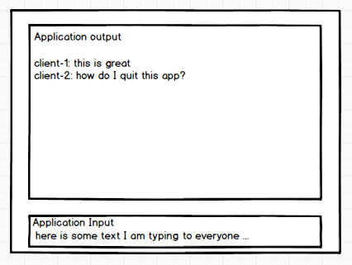
Chat service Design
Step 7: Client UI design
How to make / layout PyQT
Mockups are a great place to start
-whiteboard
-pen and paper
-Balsamiq
-Graph paper
-Powerpoint
-Photoshop / an.other art package
-etc

Slide 24
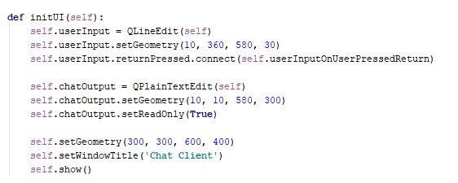
Chat service Design
Step 7: Client UI design
How to make / layout PyQT
UI can be hard coded in Python (Widget.Init)
Use code to:
1.Create Qt components
2.Position and size them
3.Add callbacks for functionality
4.Set any widget-specific states

Slide 25
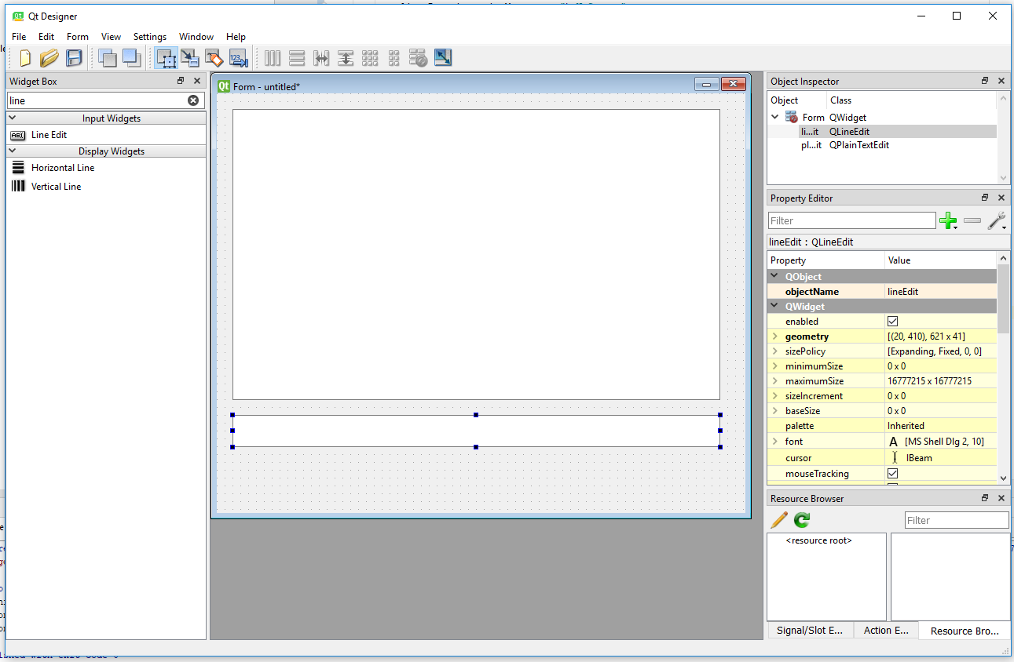
Chat service Design
Step 7: Client UI design
How to make / layout PyQT
Use Qt Designer
Python\Python37-32\Lib\site-packages\pyqt5_tools
https://stackoverflow.com/questions/18429452/convert-pyqt-ui-to-python

Slide 26
Chat service key implementational issues

Slide 27
Chat service key implementational issues
How do we implement this as threaded apps?

Slide 28
Chat service key implementational issues
How do we implement this as a threaded app?
Server
Client
Current clients container
Main Thread
Receive Thread
Client data
Do main processing
Send messages
Get incoming messages
Receive Thread
Main thread (Qt widget event processing)
Queue of work
Get incoming messages
Do event-driven processing
Send messages to server
Update with widget.timerEvent(100ms)
Accept Thread
Wait for clients
background Thread
Maintain socket connectivity

Slide 29
Chat service key implementational issues
How do we implement this as a threaded app?
For the server, it makes sense to treat the app as all the threads pushing data into the main thread through a queue
This gives the server different types of ‘work’ to do which can be specialised by data and function

Slide 30
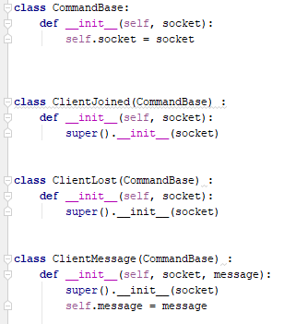
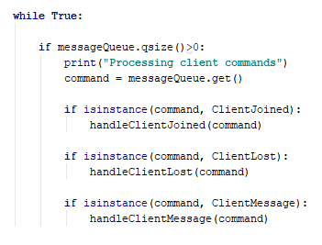
Chat service key implementational issues
How do we implement this as a threaded app?
For the server, it makes sense to treat the app as all the threads pushing data into the main thread through a queue
This gives the server different types of ‘work’ to do which can be specialised by data and function

Slide 31
Workshop
You will be able to explore and extend the functionality of the chat service in this weeks’ workshop

Slide 32
Questions

